Slide 1

Quick ‘N Speedy Delivery
TEAM MEMBERS:​
S.J SUMANTH (2010030377)​
K. SREEVARUN (2010030451)​
E. PAVAN SAI (2010030538)​
E. SHIVA GOUD (2010030542)​
Under the guidance of
DEEPTHI KALAVALA

Slide 2

Outline
Introduction and problem statement
Algorithms
Flow Chart
GITHUB Commits
Work division

Slide 3
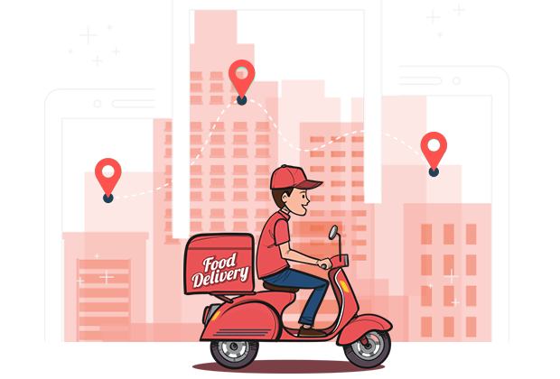
Introduction &PROBLEM STATEMENT
We have many food delivery apps like Swiggy, Zomato, Eat Sure etc.
Daily thousands of orders are made through these apps. In most cases, a driver should take more than one order at a time and deliver the same to respective customers in the given time.
So, in order to deliver all orders at the given time the delivery executive should choose the optimal path from source to destination.
He should delivery in time with minimum distance so he can save his time and get profit .

Slide 4
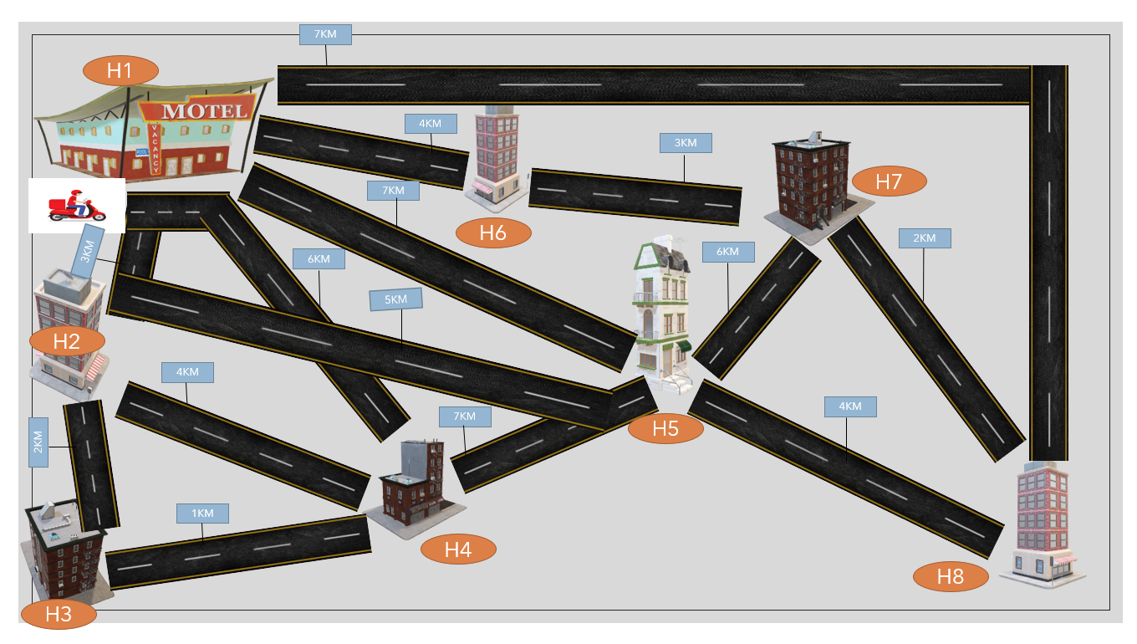

Slide 5

Problem Statement

Slide 6


Slide 7
Algorithms

Slide 8
K- Means Algorithm
The K-means clustering algorithm computes centroids and repeats until the optimal centroid is found. It is presumptively known how many clusters there are. It is also known as the flat clustering algorithm. The number of clusters found from data by the method is denoted by the letter ‘K’ in K-means.
In this method, data points are assigned to clusters in such a way that the sum of the squared distances between the data points and the centroid is as small as possible. It is essential to note that reduced diversity within clusters leads to more identical data points within the same cluster.

Slide 9
Working K- Means Algorithm
Step 1: First, we need to provide the number of clusters, K, that need to be generated by this algorithm.
Step 2: Next, choose K data points at random and assign each to a cluster. Briefly, categorize the data based on the number of data points.
Step 3: The cluster centroids will now be computed.
Step 4: Iterate the steps below until we find the ideal centroid, which is the assigning of data points to clusters that do not vary.

Slide 11
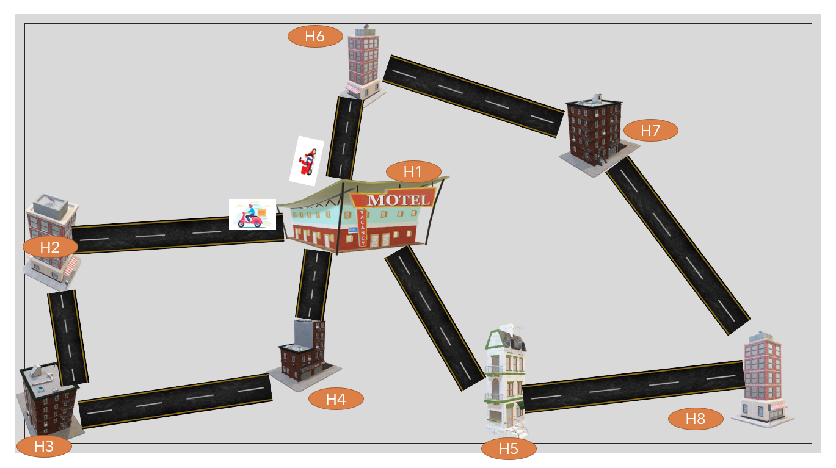

Slide 12
Ant Colony Optimization
Ant colony optimization (ACO) is a population-based metaheuristic that can be used to find approximate solutions to difficult optimization problems.
The solution construction process is stochastic and is biased by a pheromone model, that is, a set of parameters associated with graph components (either nodes or edges) whose values are modified at runtime by the ants.

Slide 13
Working of Ant Colony Optimization
First, each ant in the colony constructs a solution based on previously deposited pheromone trails.
Next ants will lay pheromone trails on the components of their chosen solution, depending on the solution’s quality.
An ant will often follow the strongest pheromone trail when constructing a solution.
However, for the ant to consider solutions other than the current best, a small amount of randomness is required in its decision process.
In addition to this, a heuristic value is also computed and considered helping to guide the search process towards the best solutions.
In the example of the multiple traveling salesman problem this heuristic will typically be the length of the edge between the destinations being considered - the shorter the edge, the more likely an ant will pick it.

Slide 14
For Travelling Salesman - 1
 | H1 | H2 | H3 | H4 | H5 | H6 | H7 | H8
H1 | 0 | 3 | --- | 6 | 7 | 4 | -- | --
H2 | 3 | 0 | 2 | -- | -- | --- | -- | --
H3 | -- | 2 | 0 | 1 | -- | -- | --- | --
H4 | 6 | -- | 1 | 0 | -- | -- | -- | --

Slide 15
For Travelling Salesman - 2
 | H1 | H2 | H3 | H4 | H5 | H6 | H7 | H8
H1 | 0 | 3 | --- | 6 | 7 | 4 | -- | --
H5 | 7 | -- | -- | -- | 0 | -- | -- | 4
H6 | 4 | -- | -- | -- | -- | 0 | 3 | --
H7 | -- | -- | -- | -- | -- | 3 | 0 | 2
H8 | -- | -- | --- | -- | 4 | -- | 2 | 0

Slide 16

Flow Chart

Slide 18
GITHUB Commits
https://github.com/STARTECH-2/Quick-N-Speedy-Delivery.git

Slide 19
Work division
SUMANTH(377)→Information collection, PPT.
SREEVARUN(451)→Information collection.
PAVAN SAI(538)→Information collection.
SHIVA GOUD(542)→Information collection, PPT.

Slide 20


